Slide 1

Futurense
Democratizing Tech Talent to deliver impact at scale

Slide 2
Healthcare Reporting

Slide 3

Index:
Overview
Tools and Technologies Used
Headline Statistics
Database’s ER diagram
Implementation Screenshots/Code Snippets
Highlights
Optimizations and Best Practices Used
Roadblocks & Resolutions
Future Scope

Slide 4
Overview
The healthcare database, comprising 13 interconnected tables, forms a comprehensive system for efficiently storing, retrieving, and analyzing medical and insurance-related data.
Intricate structure encompasses patient details, treatment histories, insurance claims, and pharmaceutical information. By interlinking data points, the database offers insights into treatment effectiveness, insurance trends, and pharmaceutical supply management.
It empowers healthcare professionals to make informed decisions, streamline insurance claims, and ensure optimal patient care.
Ultimately, this database serves as a pivotal tool for addressing multifaceted healthcare challenges through data-driven approaches.

Slide 5


Tools and Technologies Used:

Slide 6
Headline Statistics:
Average execution time of a query 36ms
952 Lines of Code
Total number of functions – 15
Number of built-in functions used – 11
Number of user-defined functions used – 4
Avg. number of lines per function – 27
Number of comments written – 62
IDE/Code Editor Used – MySQL workbench

Slide 7
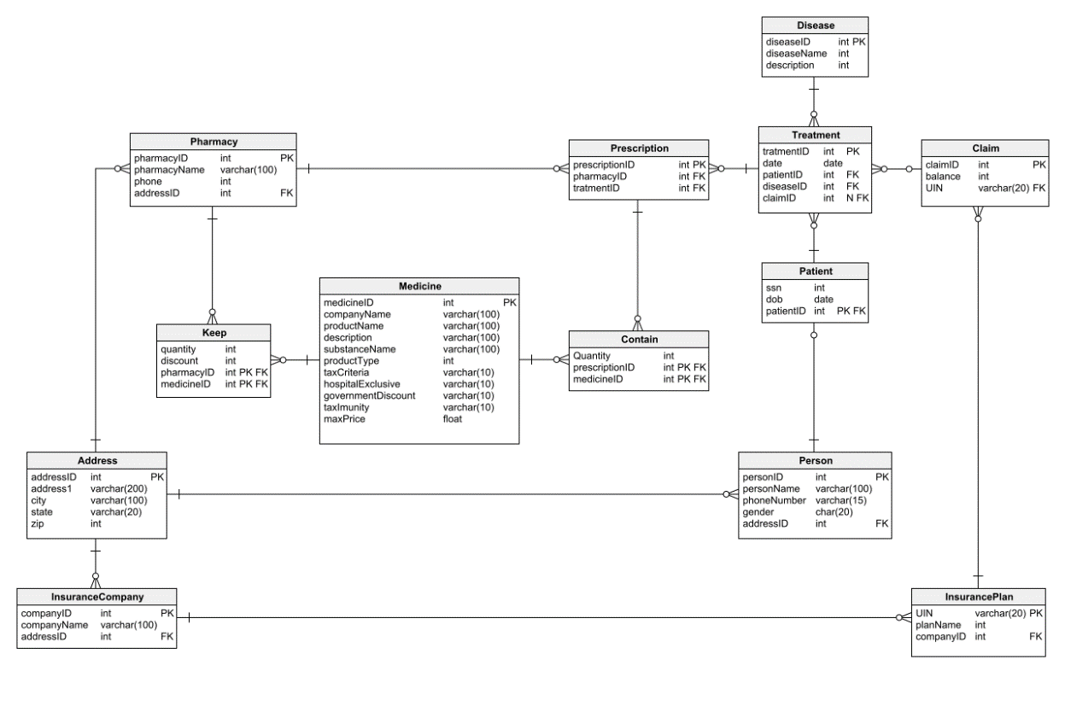
HealthCare Database Diagram

Slide 8
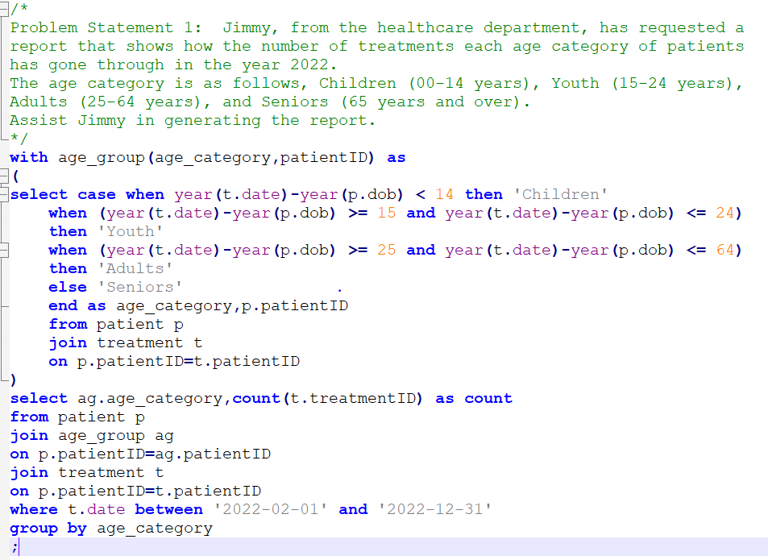
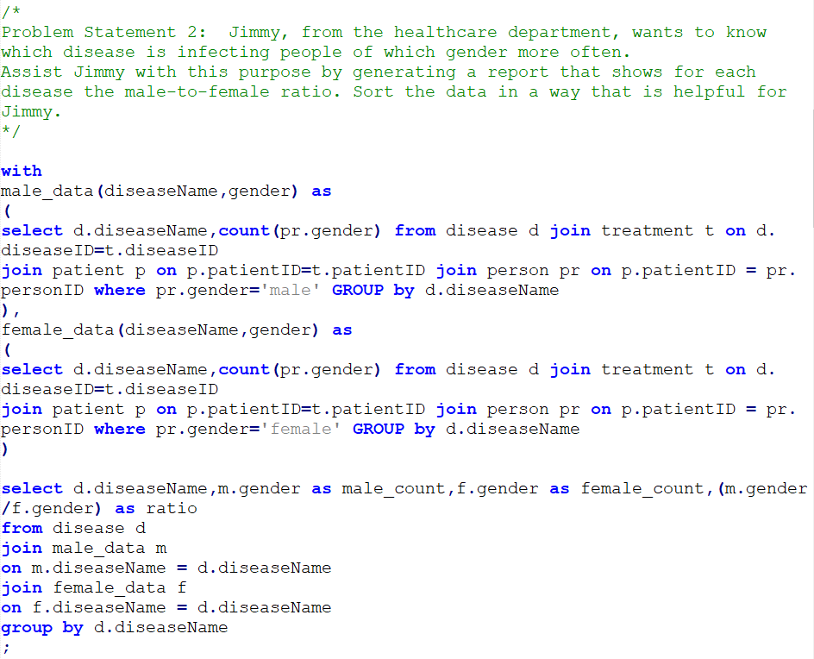
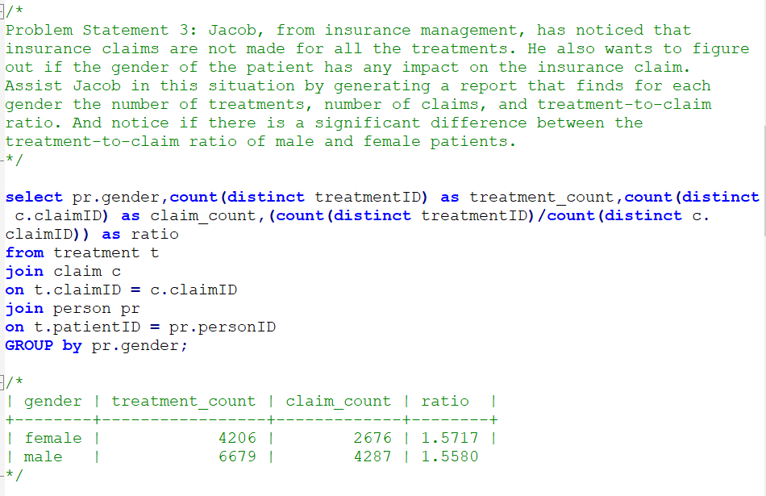
Implementation Screenshots/Code Snippets:
#01
#02
#03

Slide 9
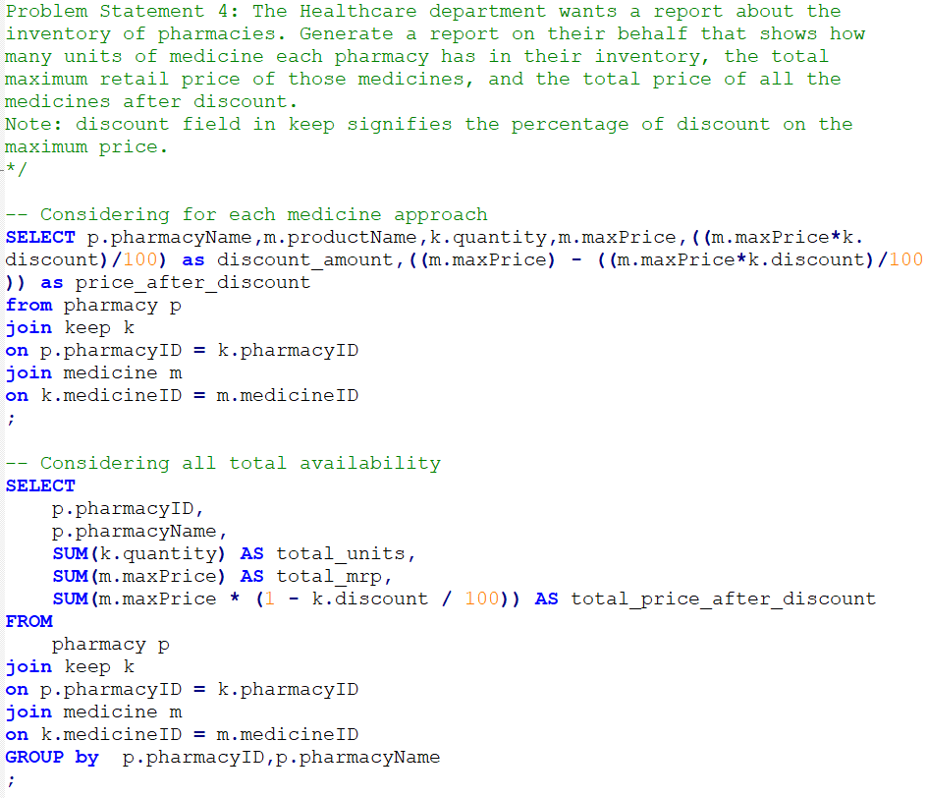
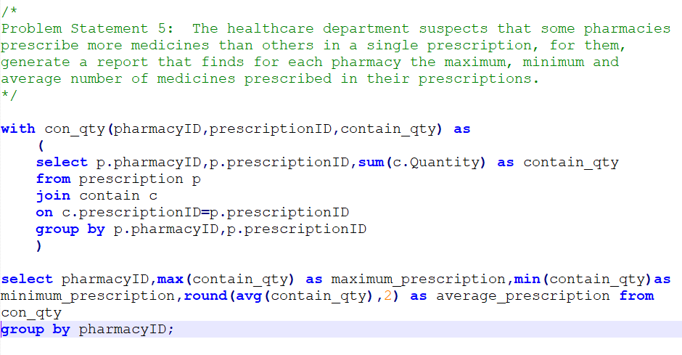
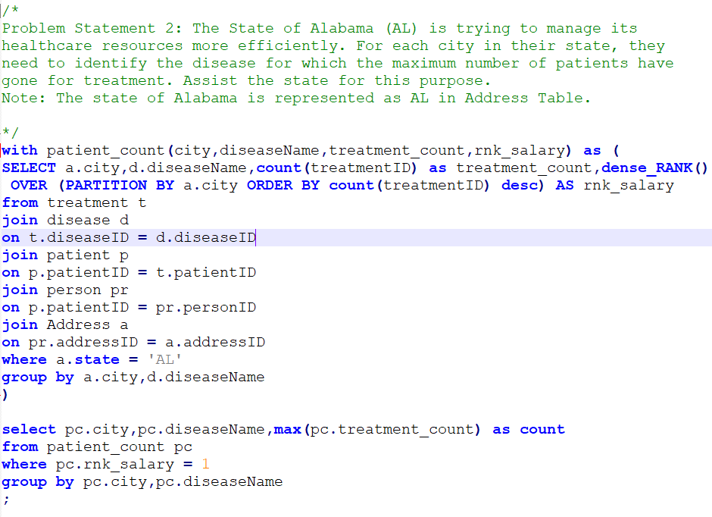
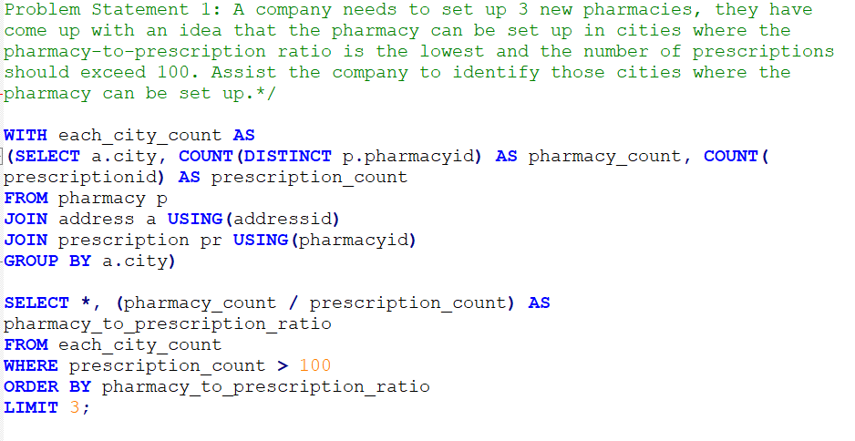
Implementation Screenshots/Code Snippets:
#05
#04
#06
#07

Slide 10
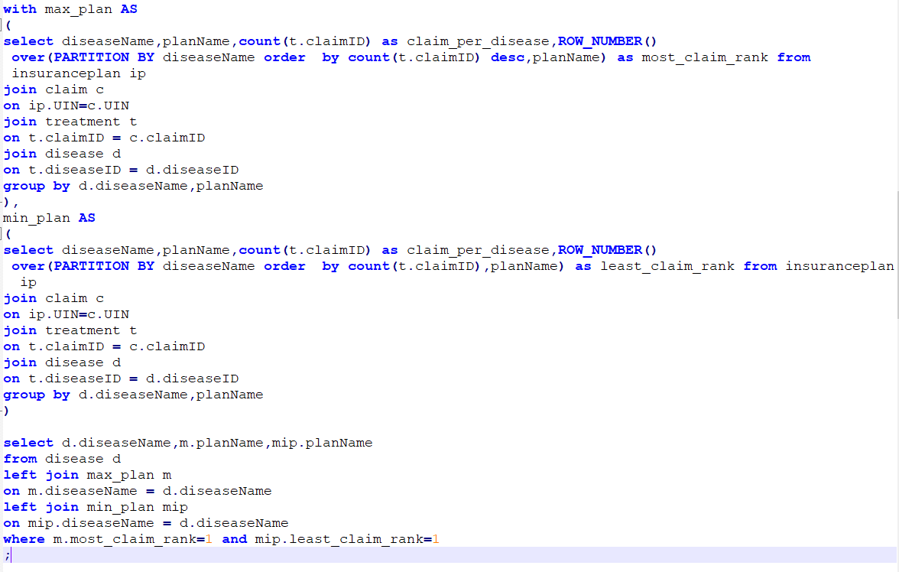
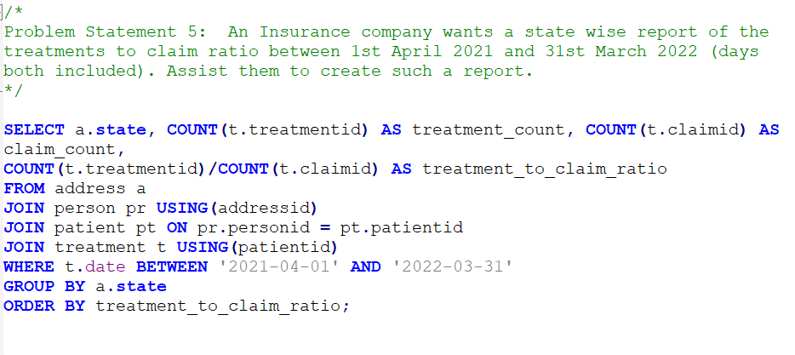
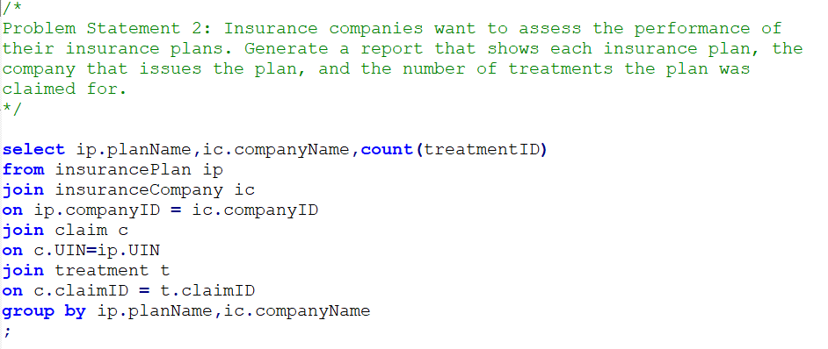
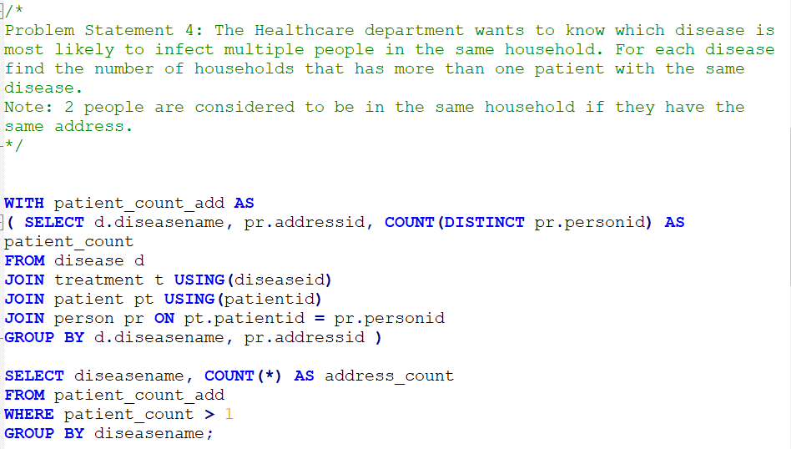
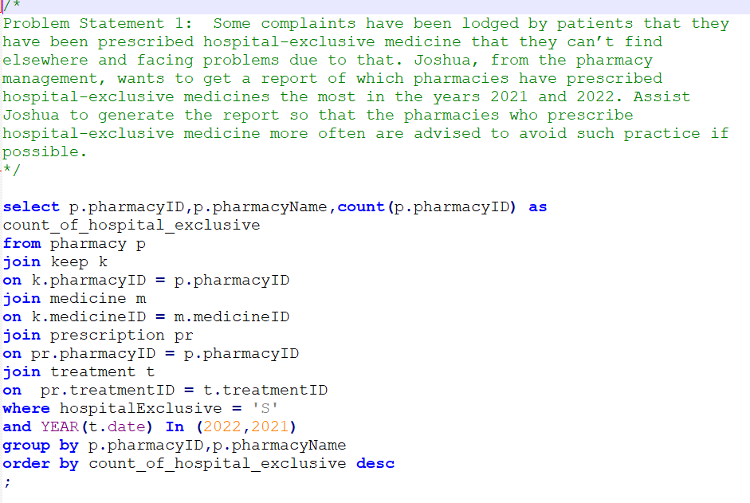
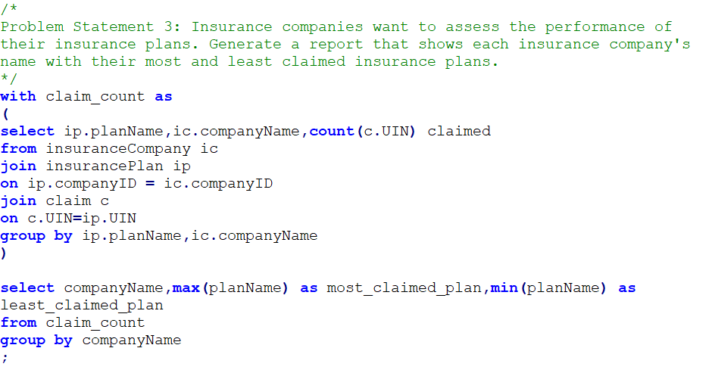
Implementation Screenshots/Code Snippets:
#08
#10
#12
#09
#11
#13

Slide 11
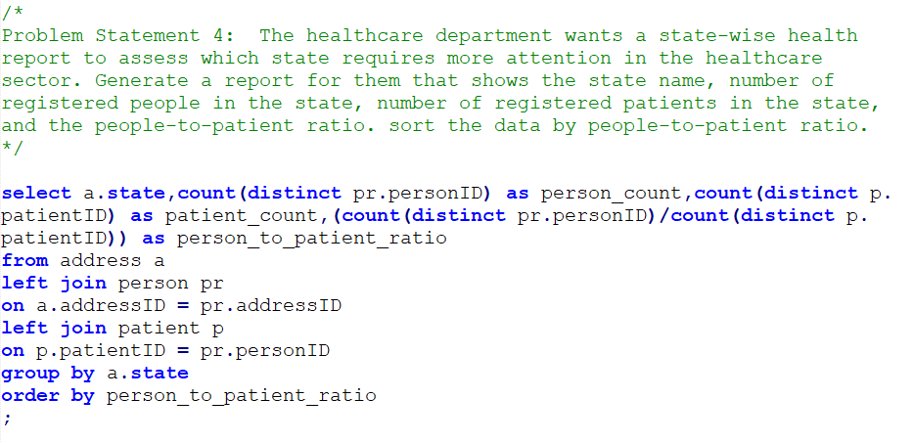
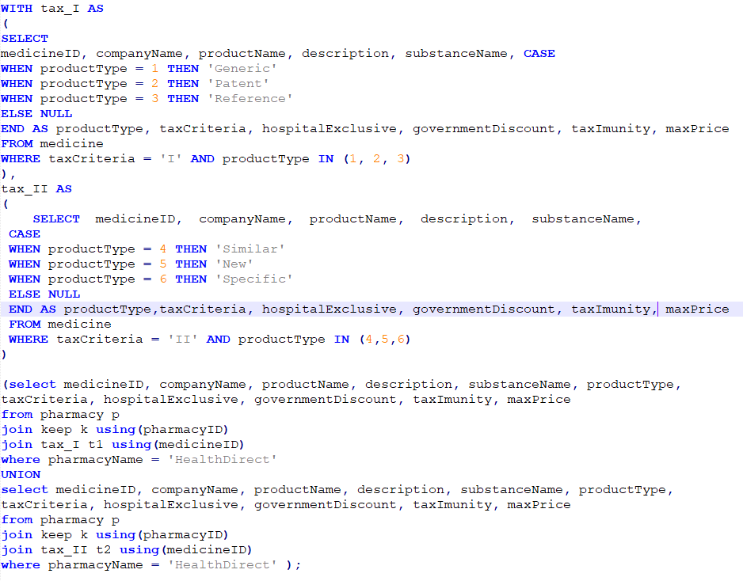
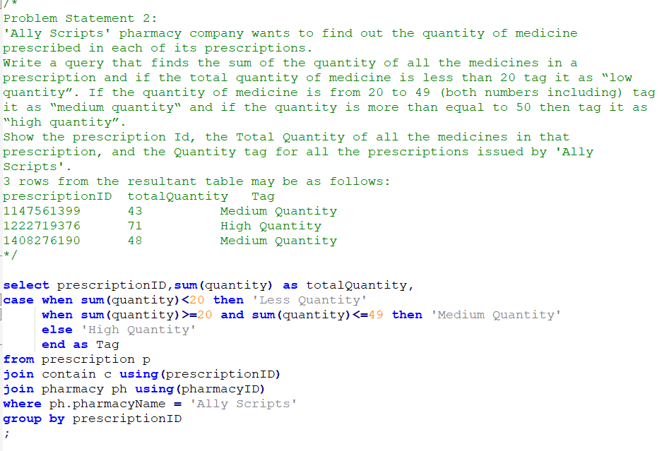
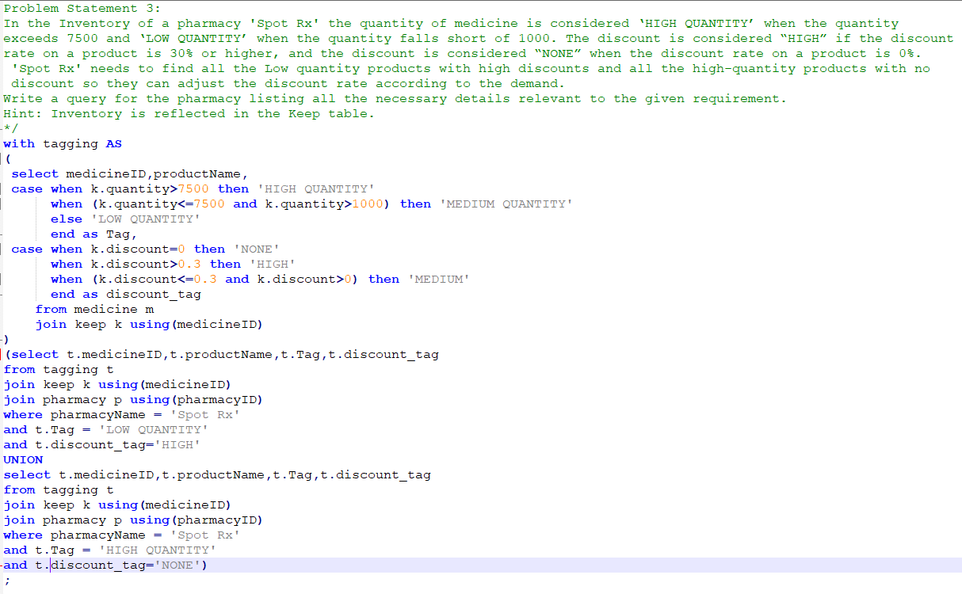
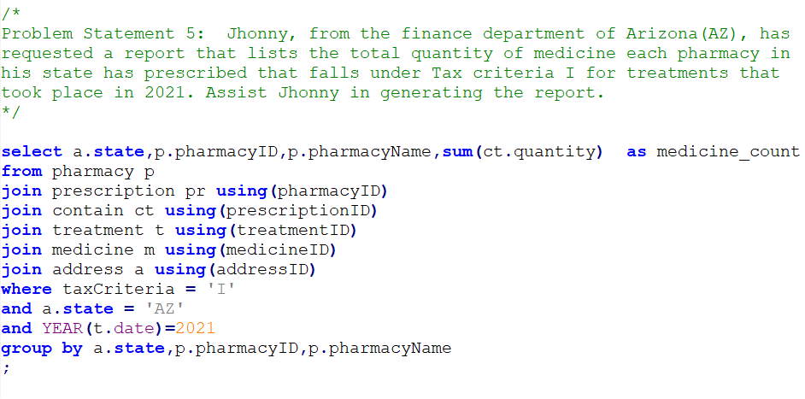
Implementation Screenshots/Code Snippets:
#17
#14
#18
#15
#16

Slide 12
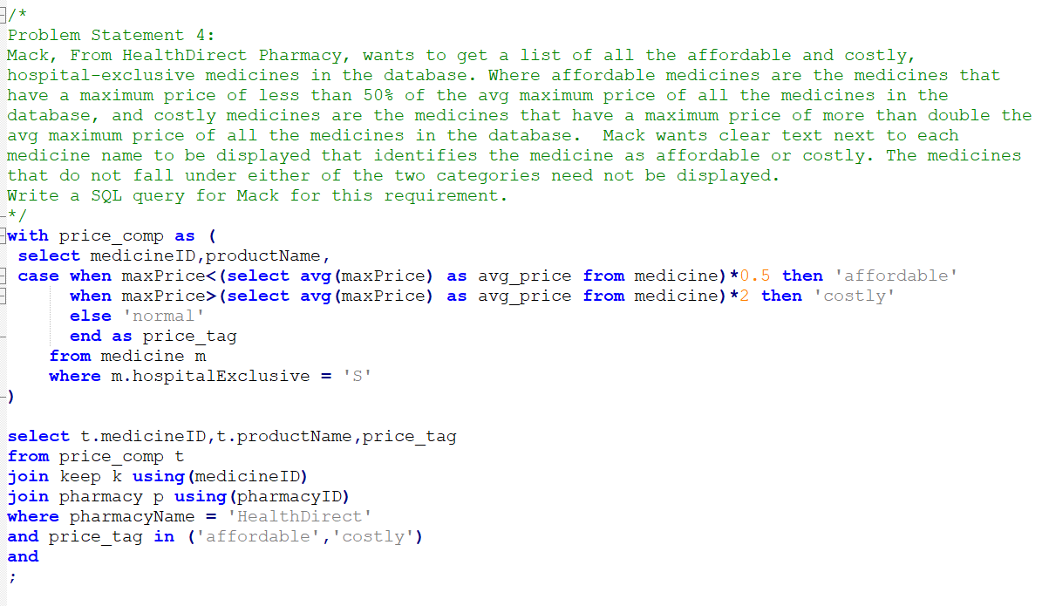
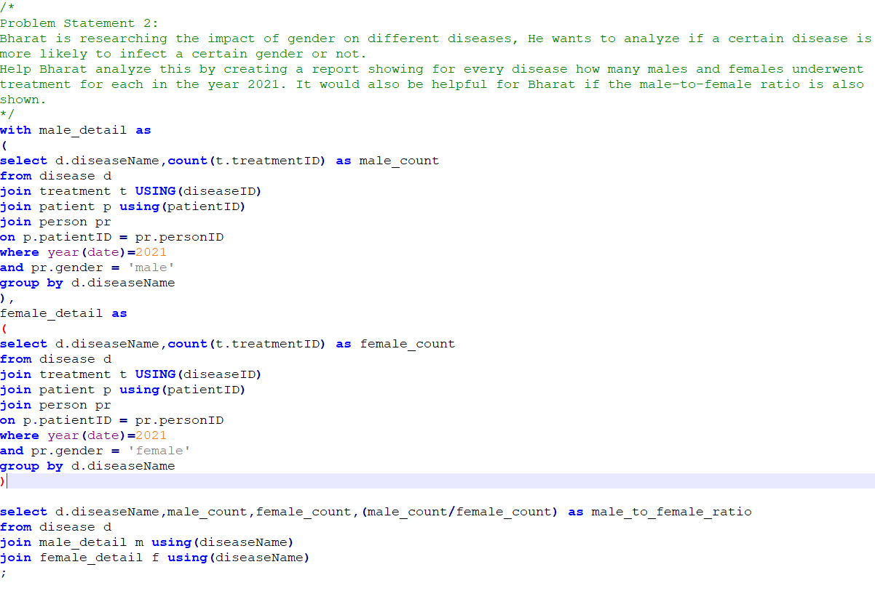
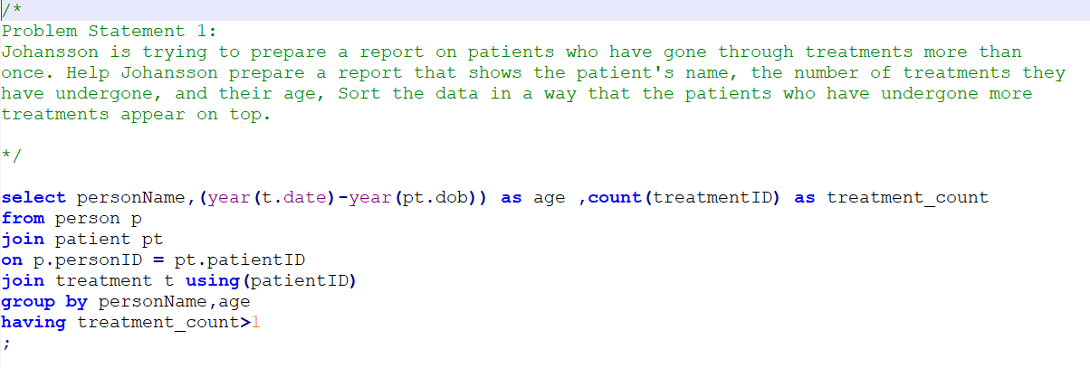
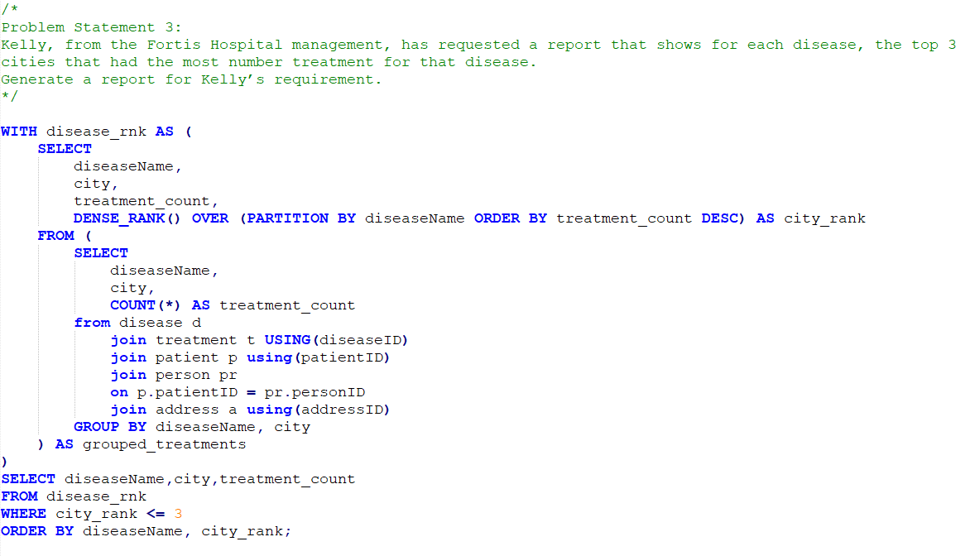
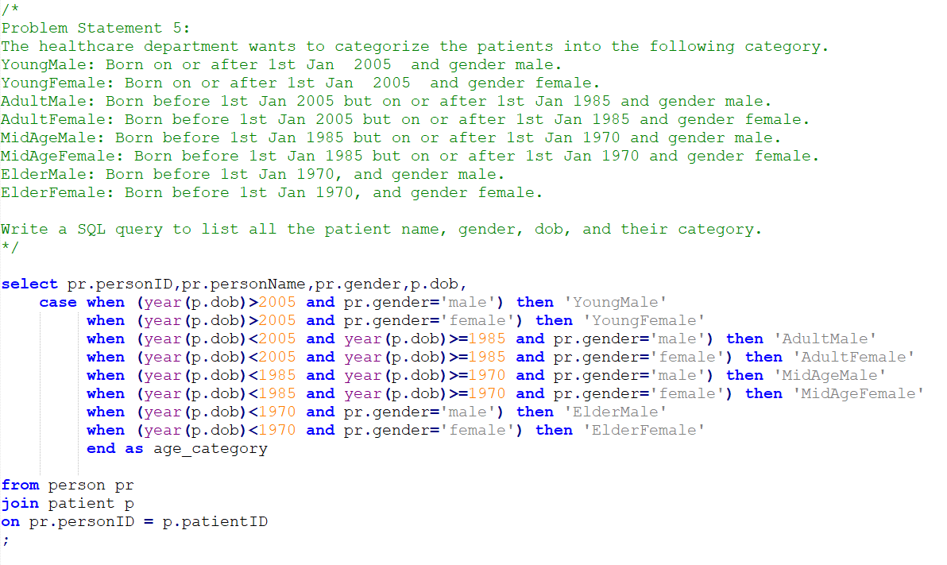
Implementation Screenshots/Code Snippets:
#21
#19
#22
#20
#23

Slide 13
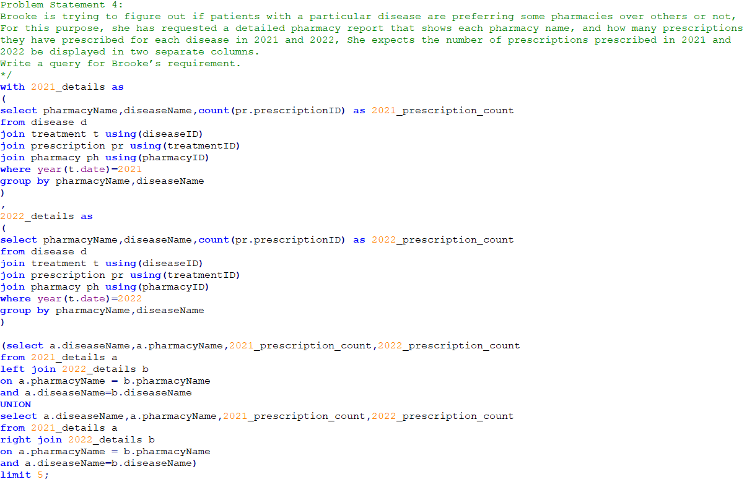
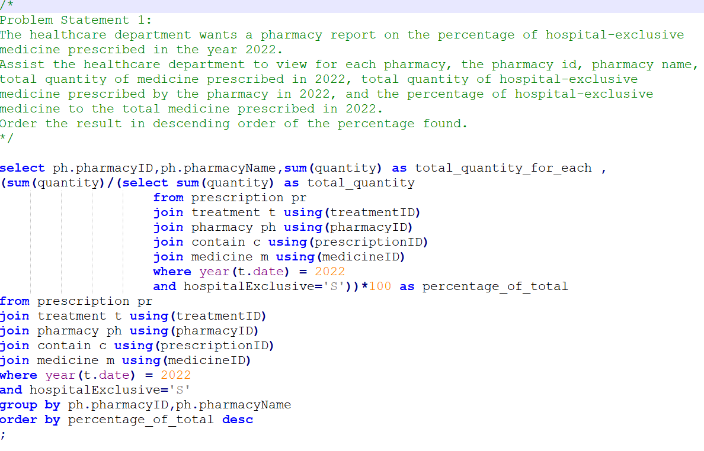
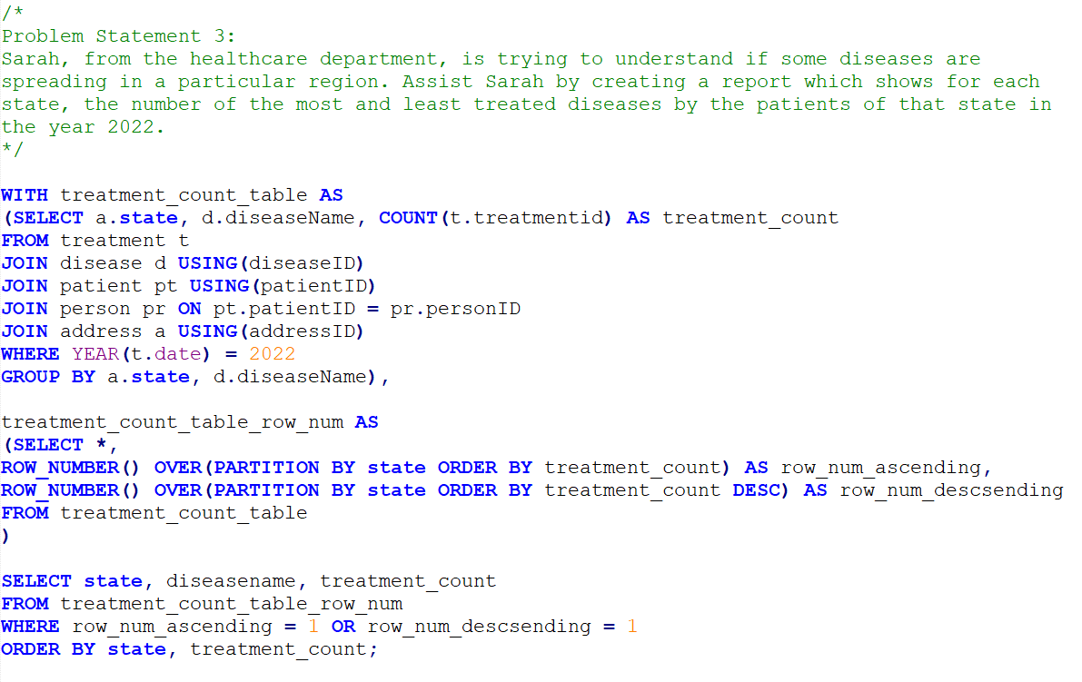
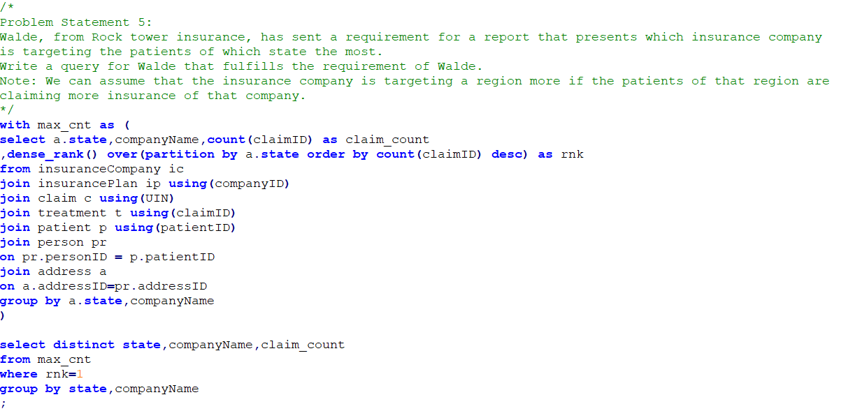
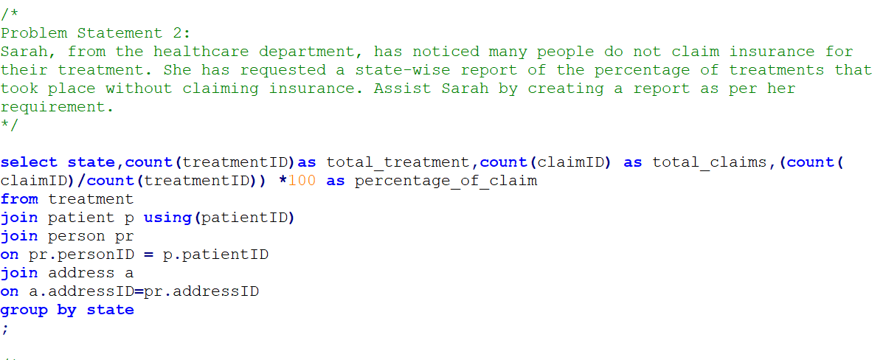
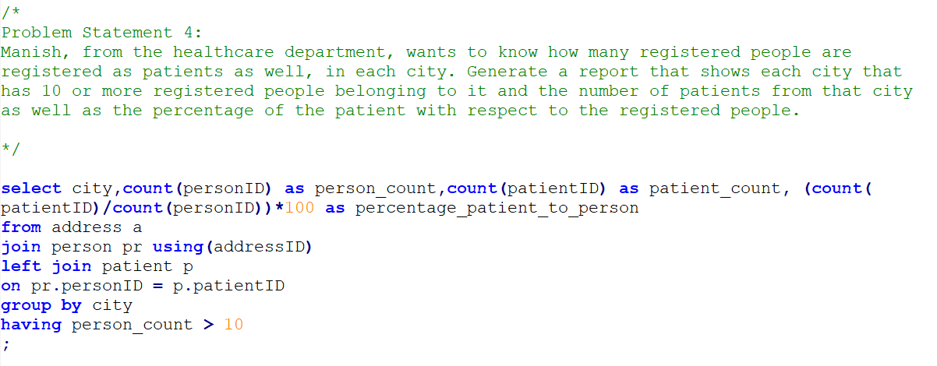
Implementation Screenshots/Code Snippets:
#24
#26
#28
#27
#29
#25

Slide 14
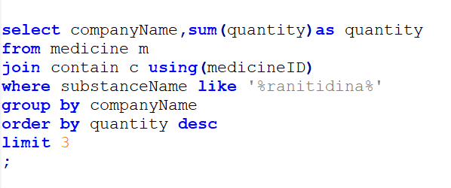
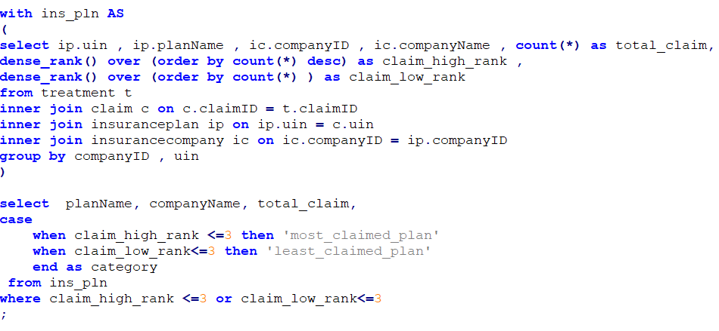
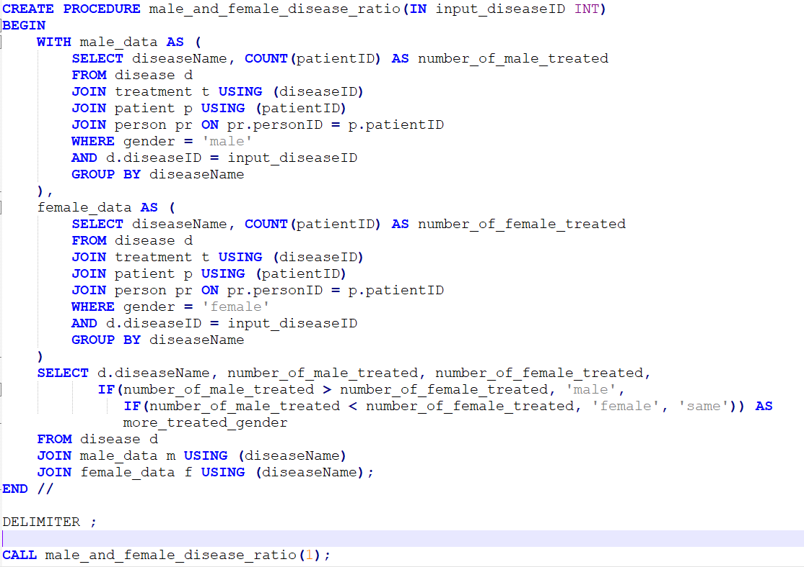
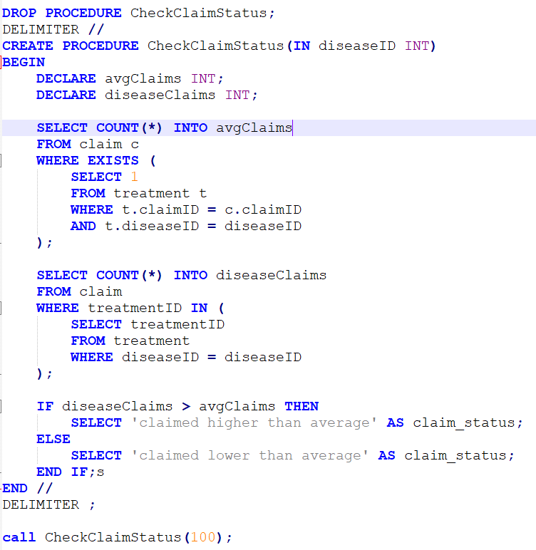
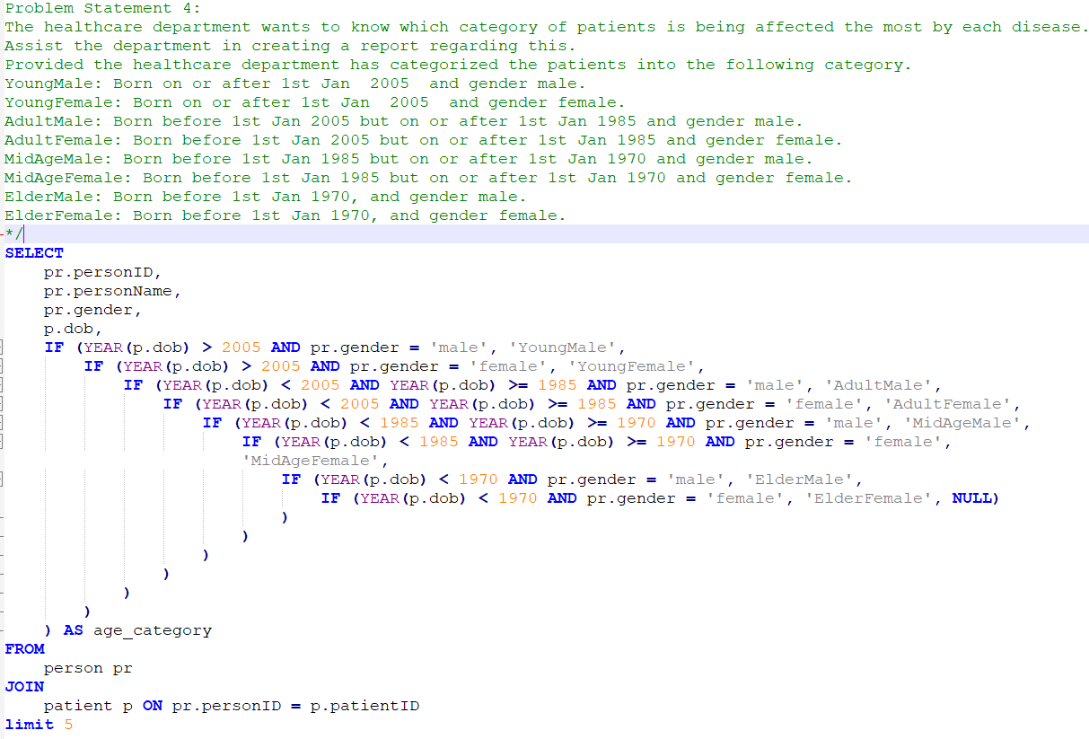
Implementation Screenshots/Code Snippets:
#30
#33
#32
#34
#31

Slide 15
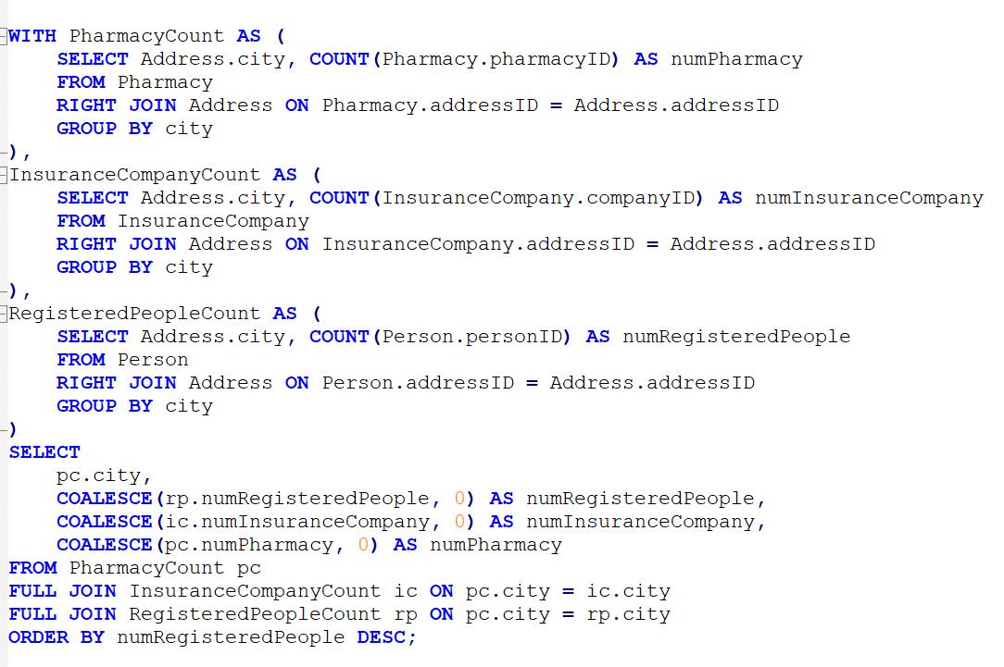
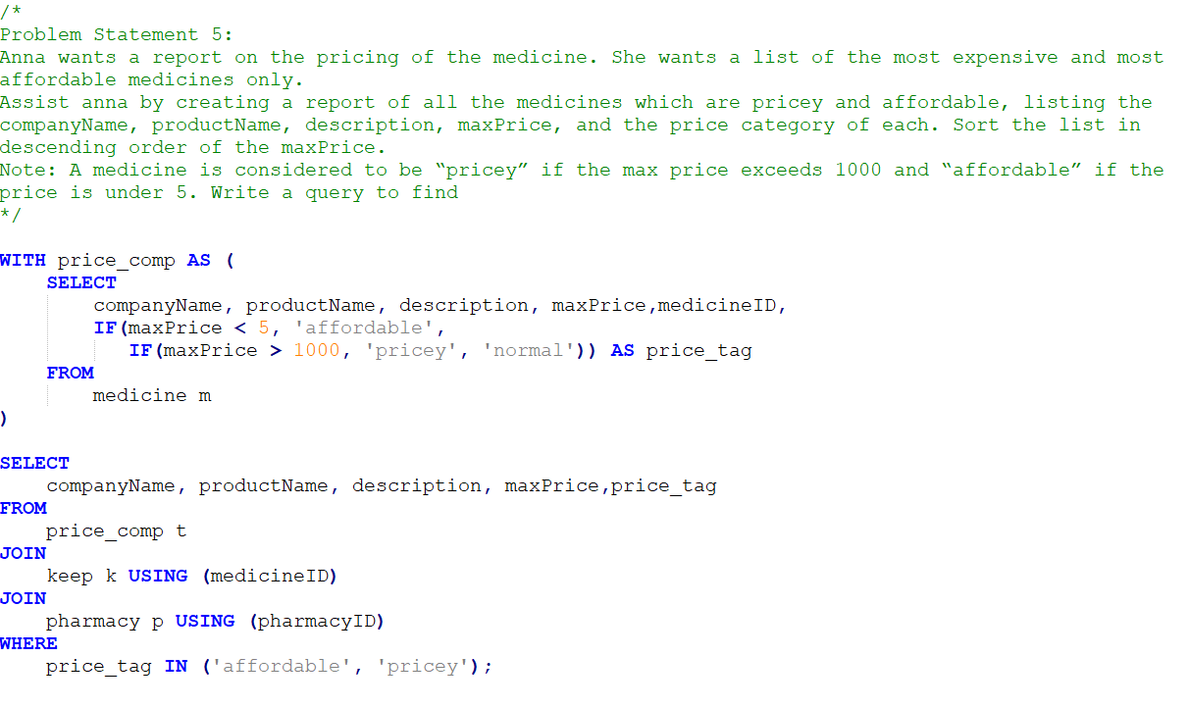
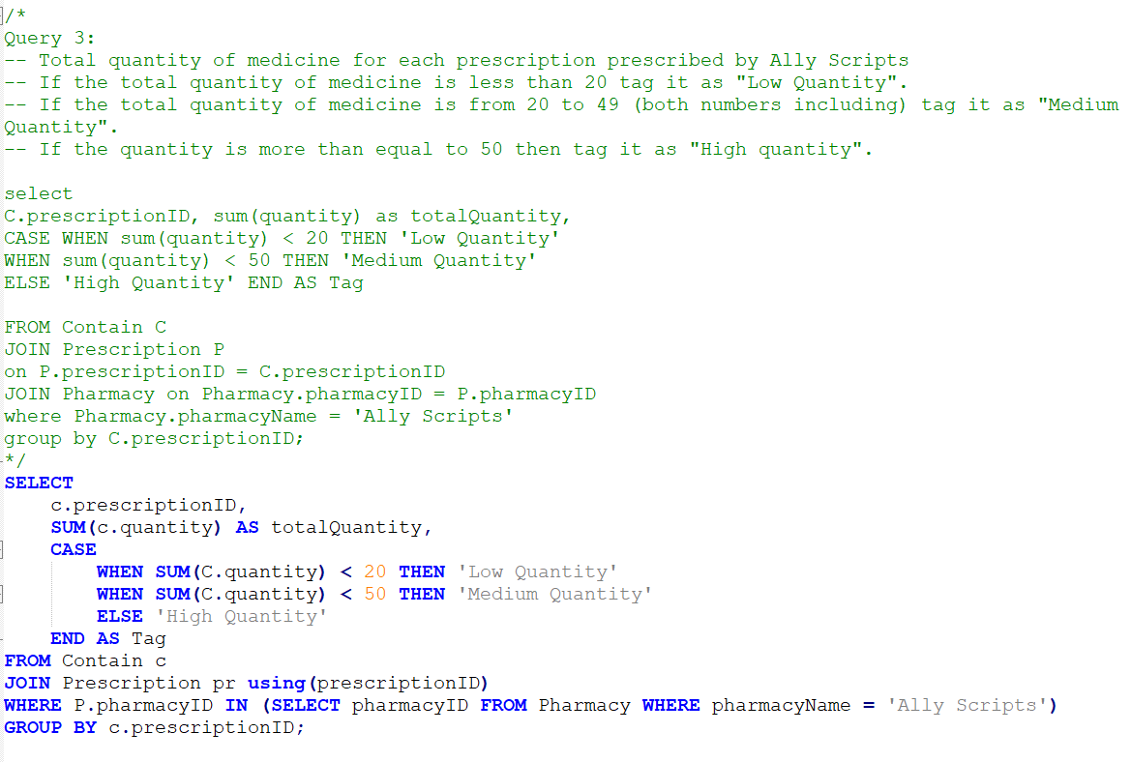
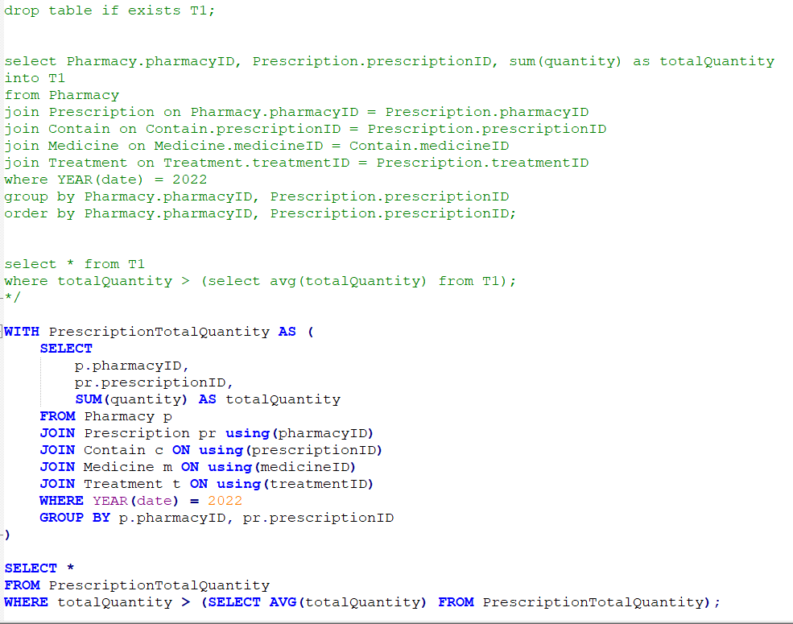
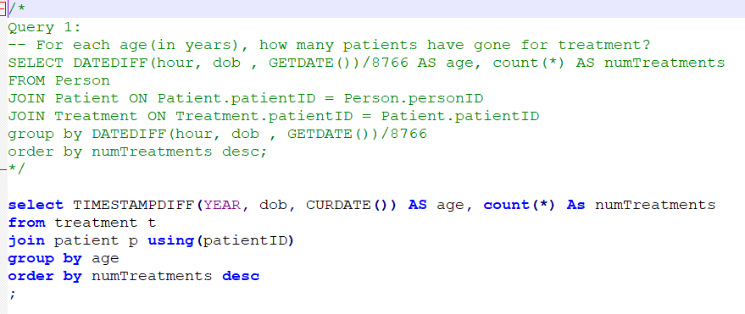
Implementation Screenshots/Code Snippets:
#38
#35
#39
#36
#37

Slide 16
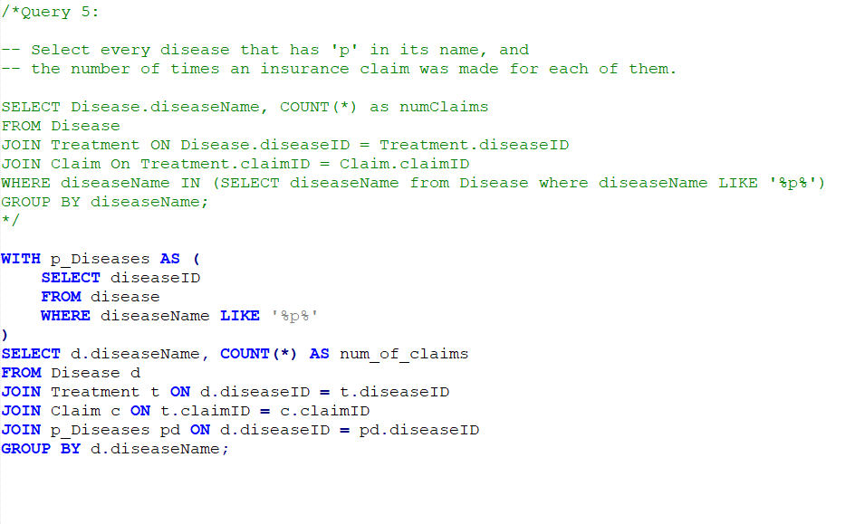
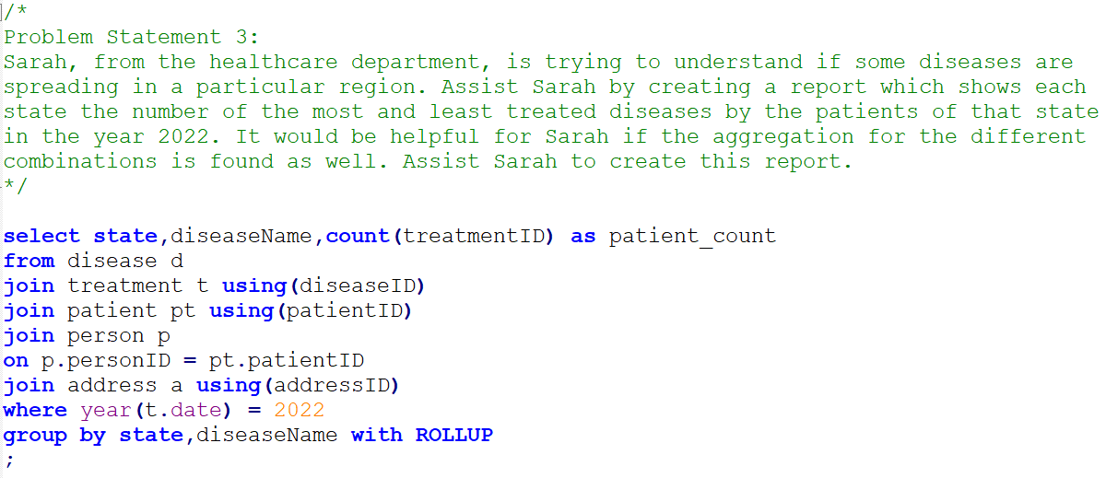
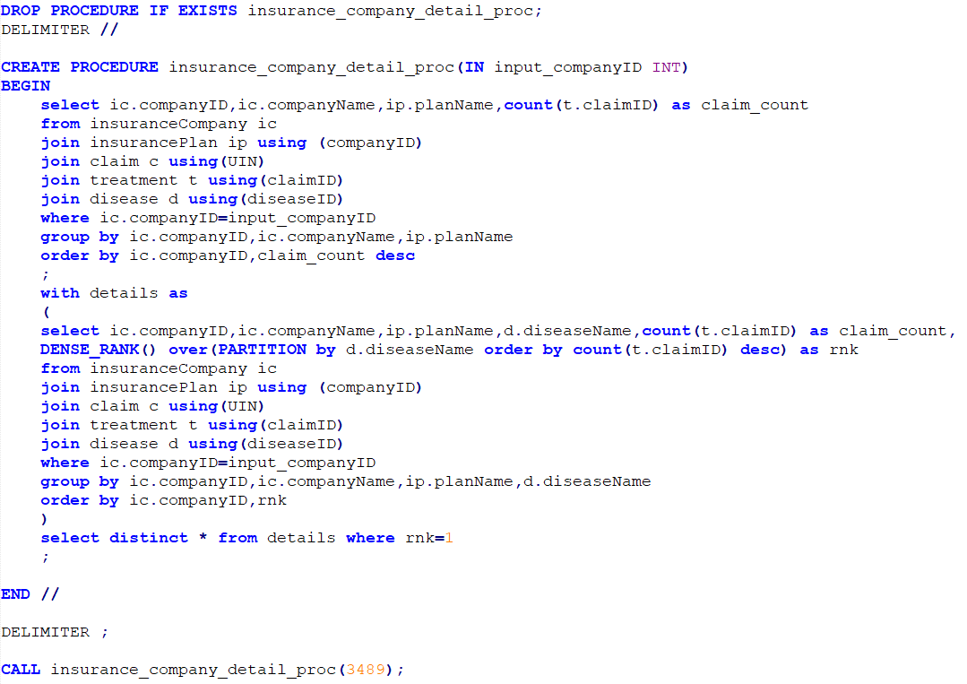
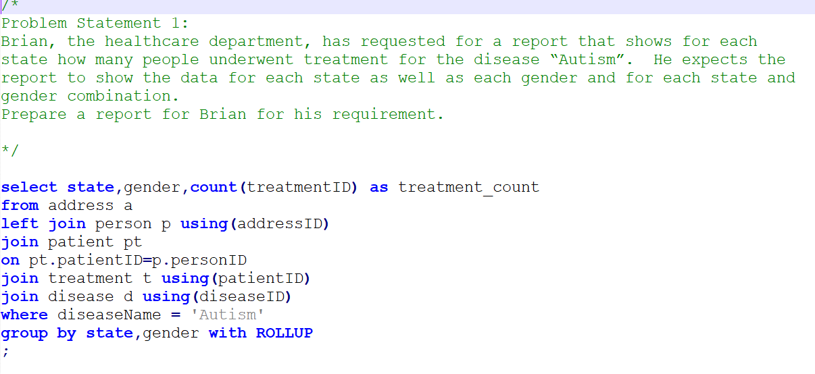
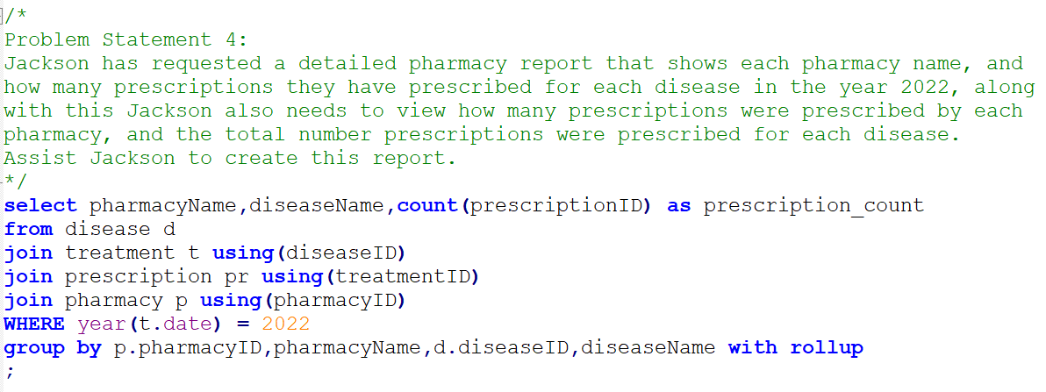
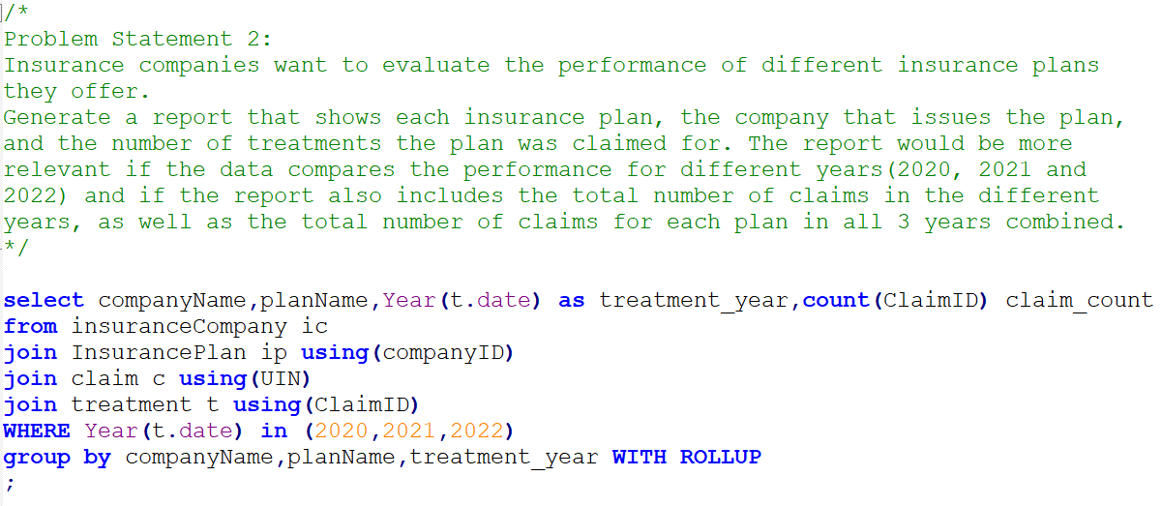
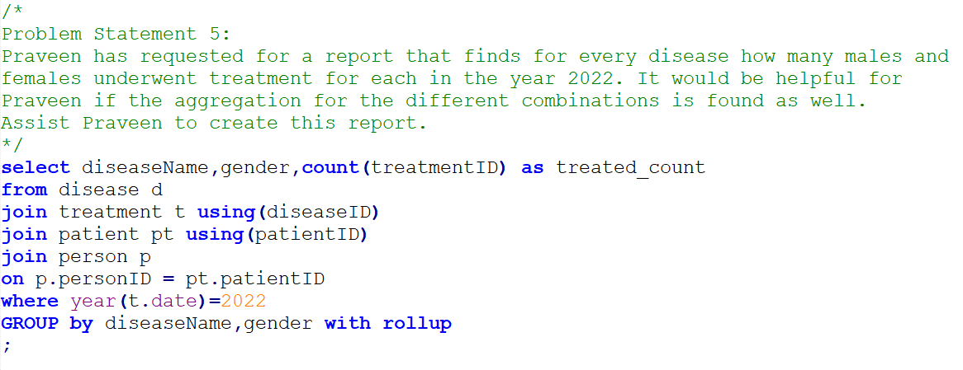
Implementation Screenshots/Code Snippets:
#40
#43
#44
#41
#42
#45
#46

Slide 17
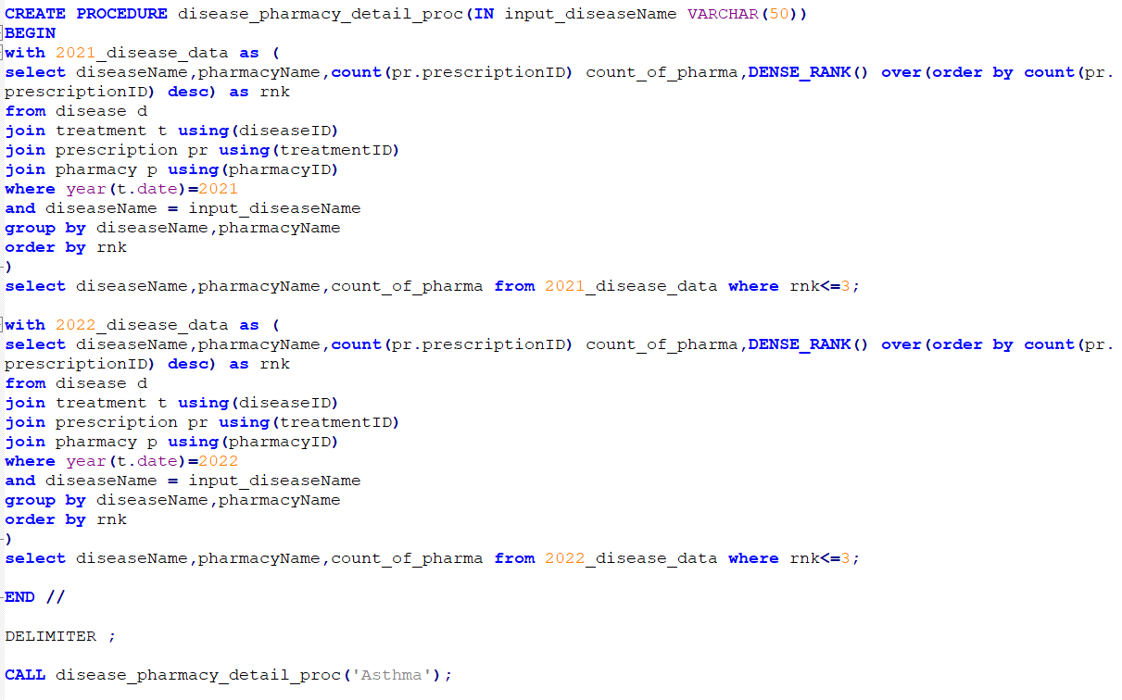
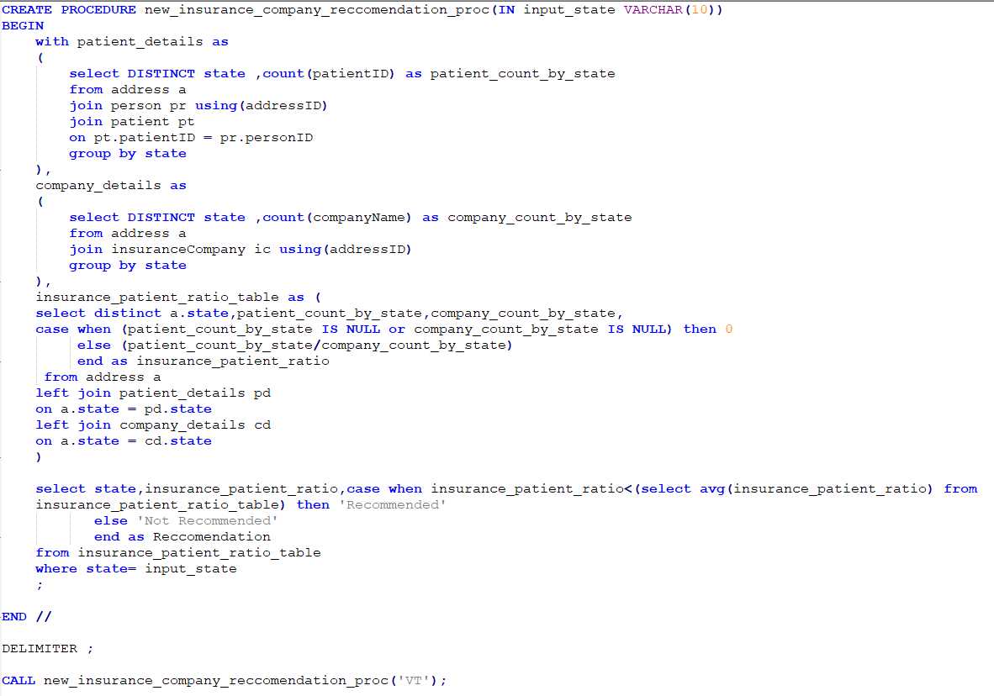
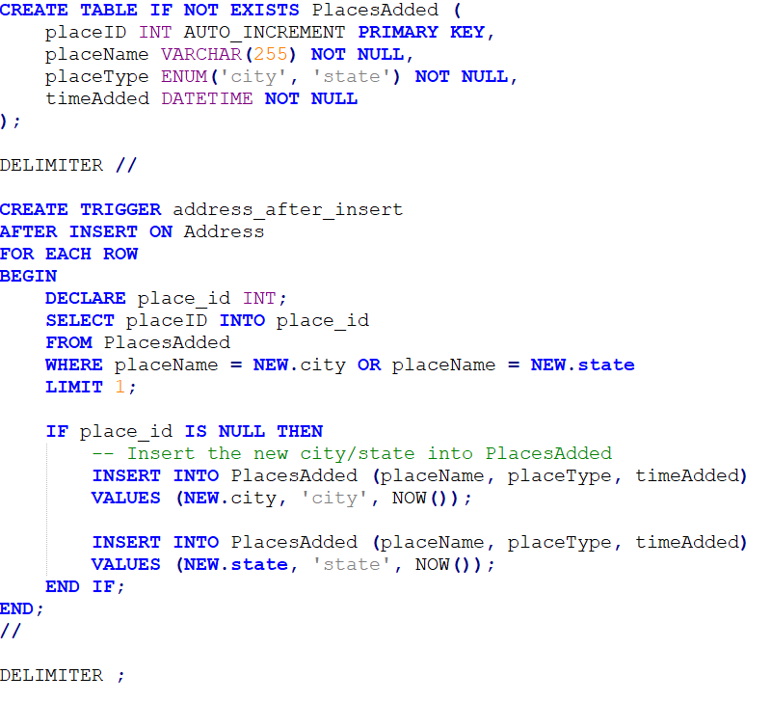
Implementation Screenshots/Code Snippets:
#47
#48
#49

Slide 18






Implementation Screenshots/Code Snippets:
#50
#54
#51
#55
#52
#53

Slide 19
Highlights:
Utilized diverse optimization techniques to enhance query performance, ensuring efficiency and speed.
Employed Common Table Expressions (CTEs) to enhance query readability and reusability, enabling multiple references.
Leveraged advanced features such as window functions and roll-up to gain deeper insights from the data.
Developed stored routines like triggers, functions, and procedures for streamlined and consistent operations.
Incorporated conditional statements like IF-ELSE and CASE to enable dynamic logic in queries.
Demonstrated expertise in applying various built-in functions and subqueries, resulting in the successful achievement of the desired outcomes.

Slide 20
Optimizations and Best Practices Used:
Employed joins instead of subqueries to enhance query efficiency and reduce performance overhead.
Utilized views to encapsulate complex logic and enhance query structure. Leveraged CTEs to improve code readability and enable reusable components.
Avoided unnecessary creation of temporary tables, reducing overhead and contributing to faster execution times.
Opted for direct approaches over correlated subqueries, streamlining query formulation and minimizing resource consumption.
Used the 'EXPLAIN' keyword to analyze query execution plans, identify bottlenecks, and fine-tune queries for better performance.

Slide 21
Roadblocks & Resolutions
Resolution:-
1. Created combined primary key to resolve the issue of column duplication in case of entire row duplication those rows are dropped.
Claim Table:-Compound primary key ClaimID + UIN
Insurance Plan:- Combined primary key UIN + CompanyID
Keep Table :- Combined primary key MedicineID + pharmacyID + quantity + discount
2. Used Notepad++ to replace the special characters.
Roadblocks:
1. Data Duplication in the primary key
2. Special Character

Slide 22
Future Scope:
Each problem statement can be approached from multiple angles. New perspectives may reveal innovative solutions or better ways to address challenges.
Room for refining, streamlining, and enhancing the solutions for better efficiency.
Consider the option of de-normalizing tables to optimize query speed. Reducing the need for extensive joins can lead to significantly faster data retrieval.

Slide 23
Project Link
Health Care Database Analysis

Slide 24
Thank You

